Slide 1

PROJECT ON
Restaurant Analysis
Amol Chavan

Slide 2
OBJECTIVE
Analyze city-wise restaurant prices, ratings, and discounts.
Identify pricing patterns and value-for-money trends.
Understand the relationship between price and customer ratings.

Slide 3
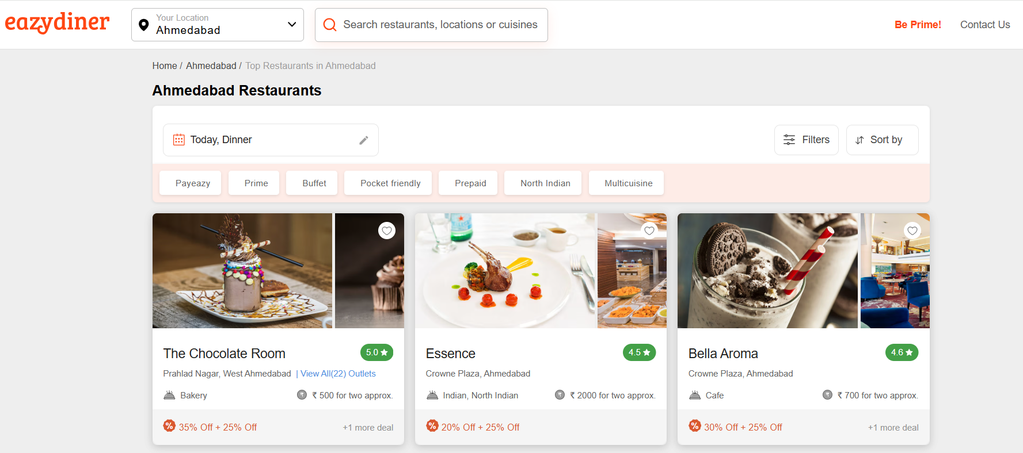
The website used for Web Scrapping and obtained the data from –
https://www.eazydiner.com/

Slide 4
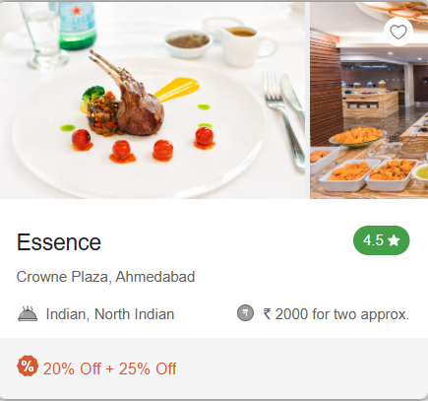
FEATURES EXTRACTED
Columns
Name Of The Restaurant
Rating
Cuisine Served
Location
Approximate Cost For 2
Discount

Slide 5
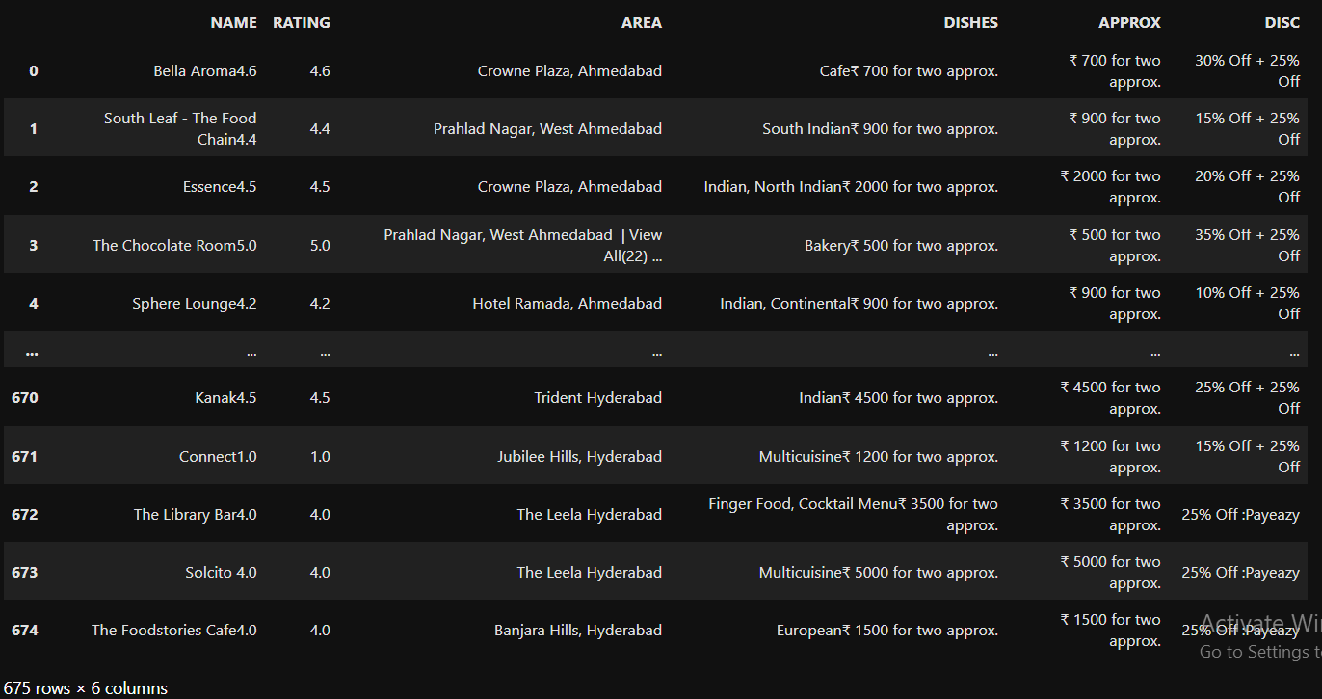
FIRST LOOK AT THE DATA-

Slide 6
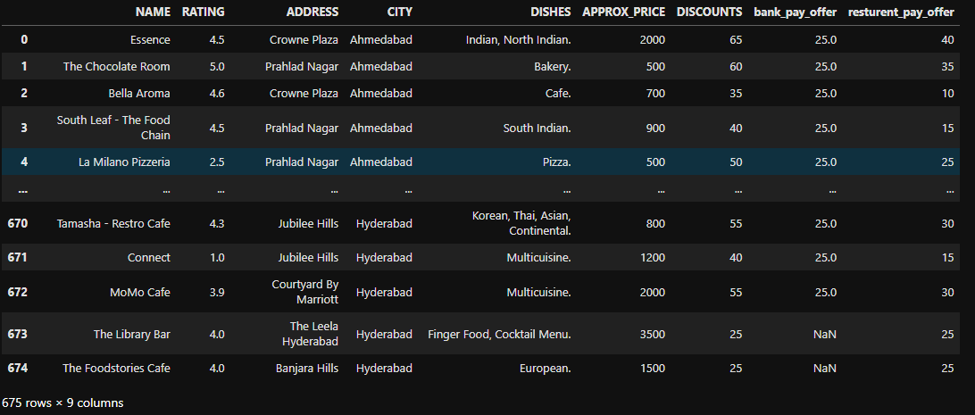
FINAL LOOK OF THE DATA-

Slide 7
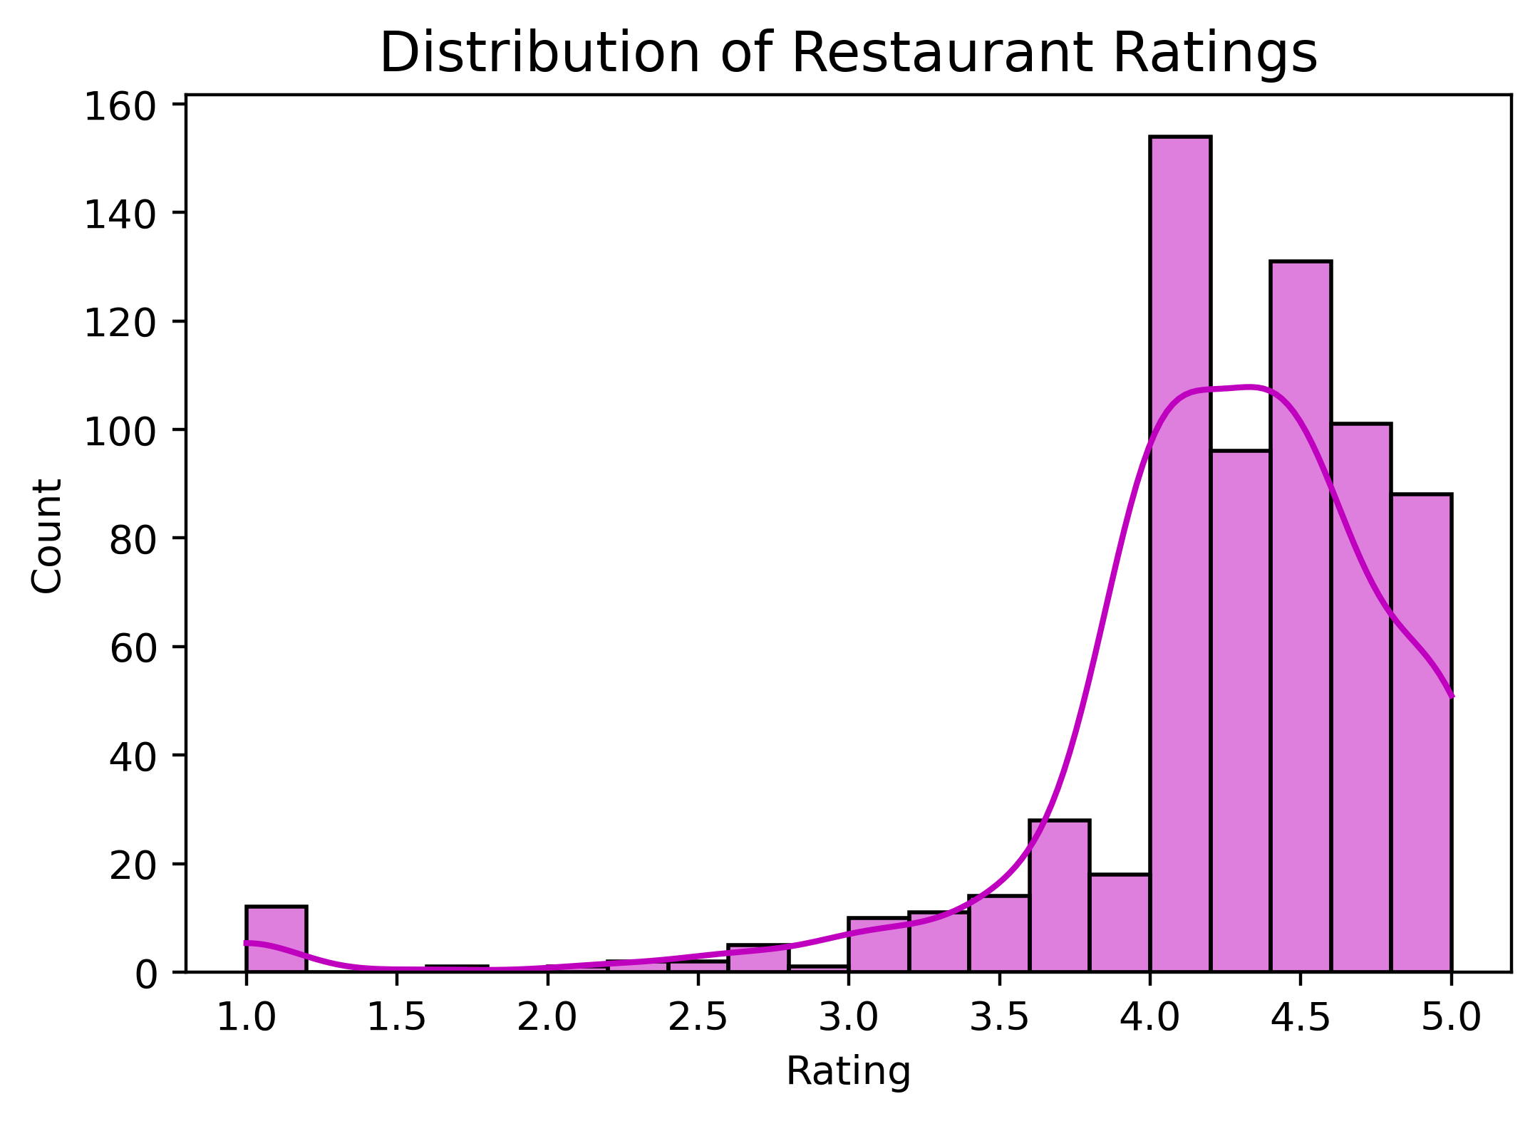
UNIVARIATE ANALYSIS
DISTRIBUTION OF RESTAURANT RATINGS
Most Restaurants Have Ratings Between 4.0 And 4.5.
Which Indicates That Most Restaurants Are Consistently High Rated.
This Shows That Overall, Restaurants Generally Maintain Good To Excellent Ratings.

Slide 8
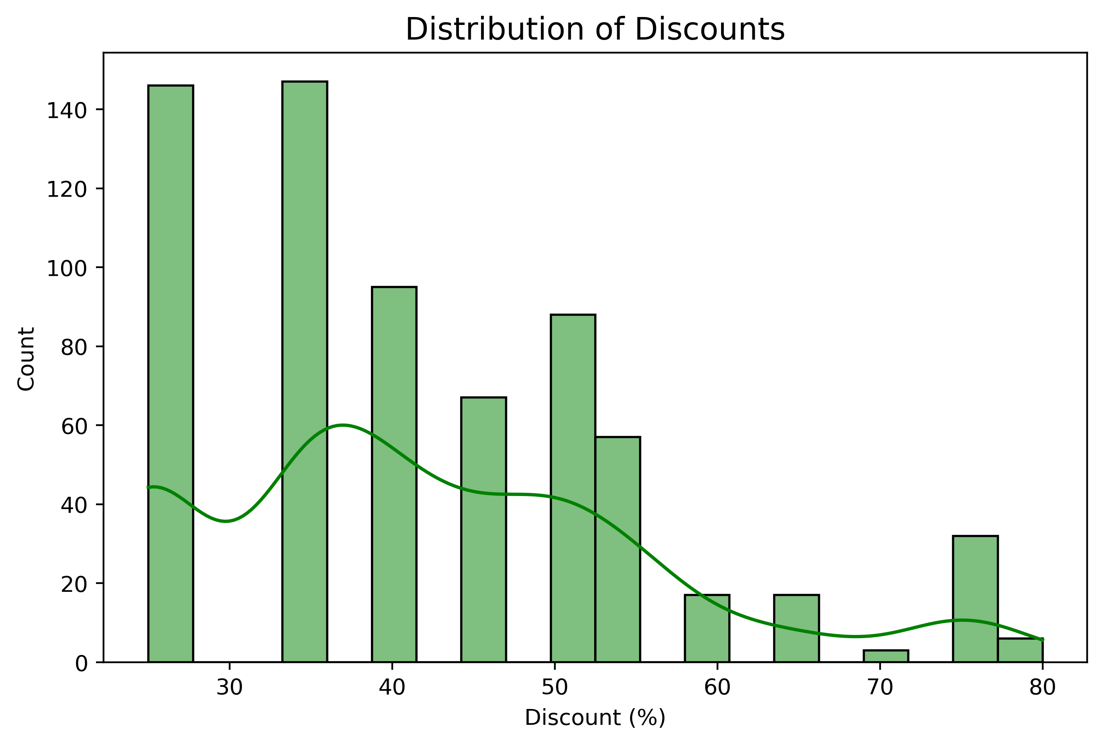
DISTRIBUTION OF DISCOUNTS
Most Discounts Are Around 30% And 35%, As These Have The Highest Count.
Discounts Between 40% To 55% Are Also Common But Less Than 30–35%.
Overall, Smaller Discounts Are More Frequent Than Very Large Discounts

Slide 9
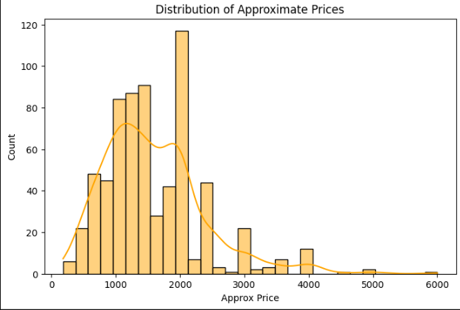
DISTRIBUTION OF PRICE
Most Restaurent prices lies between 1000 to 2000.

Slide 10
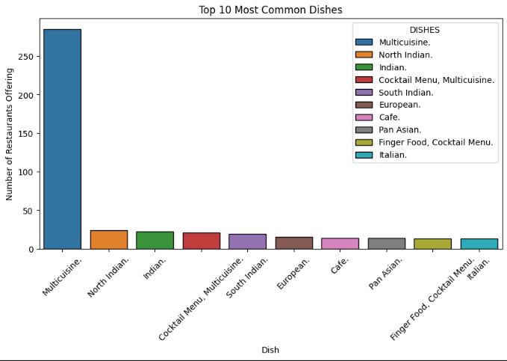

WHAT ARE THE MOST COMMON DISHES OFFERED
Multicuisine Is The Most Common Dish Offered By Restaurants (More Than 250).
North Indian And Indian Dishes Are The Next Popular, But Much Lower In Number.
South Indian, Finger Food, Pan Asian, And Cocktail Menus Are Less Common.
Italian, European, And Café-style Dishes Are The Least Offered.

Slide 11
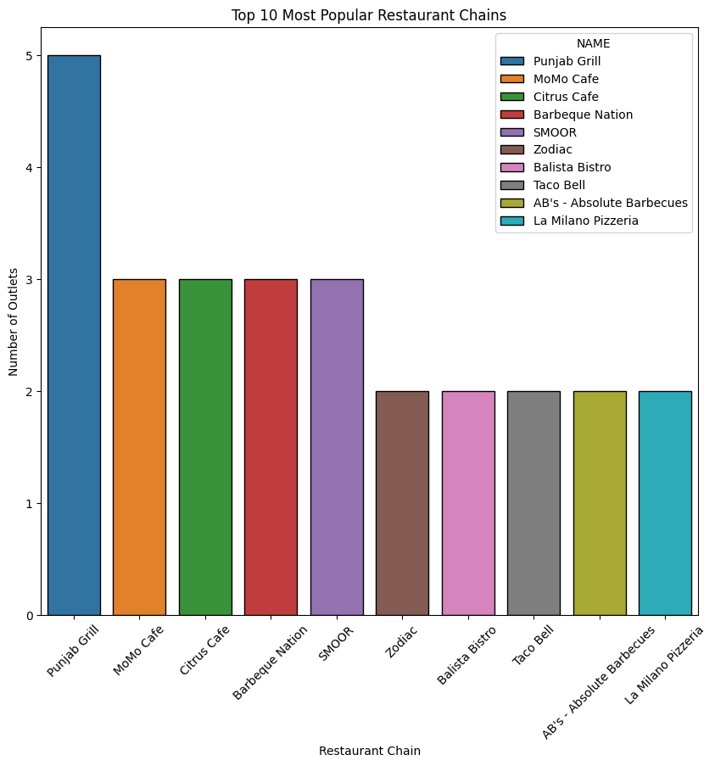
WHICH RESTAURANT CHAINS ARE THE MOST POPULAR
Here we can see the Punjab Grill have large number of branches all cities.

Slide 12
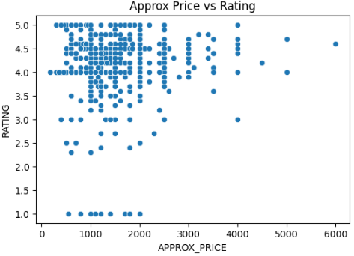
BIVARIATE ANALYSIS-
IS THERE RELATION BETWEEN PRICE AND RATING
Most Restaurants, Regardless Of Price, Have Ratings Clustered Between 4.0 To 5.0.
Low And Mid-priced Restaurants (Below 2000) Dominate The Dataset.
Price and Rating not showing any relationship between them.

Slide 13
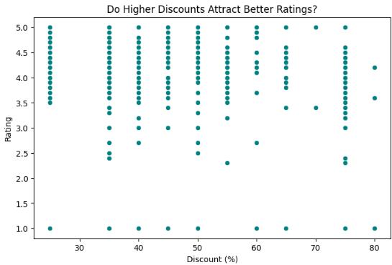
BIVARIATE ANALYSIS-
IS THERE RELATION BETWEEN DISCOUNT AND RATING
Discount and Rating don’t have any relationship between them.

Slide 14
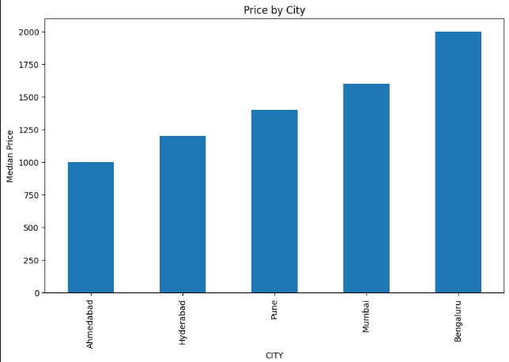
HOW DOES PRICE VARY ACROSS CITIES
Ahmedabad have lowest prices overall all cities.
Bengaluru have high prices overall cities..

Slide 15
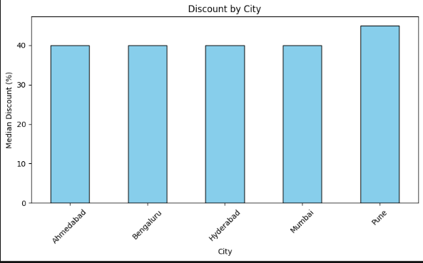
HOW DOES DISCOUNT VARY ACROSS CITIES
Pune have high discount overall cities.

Slide 16
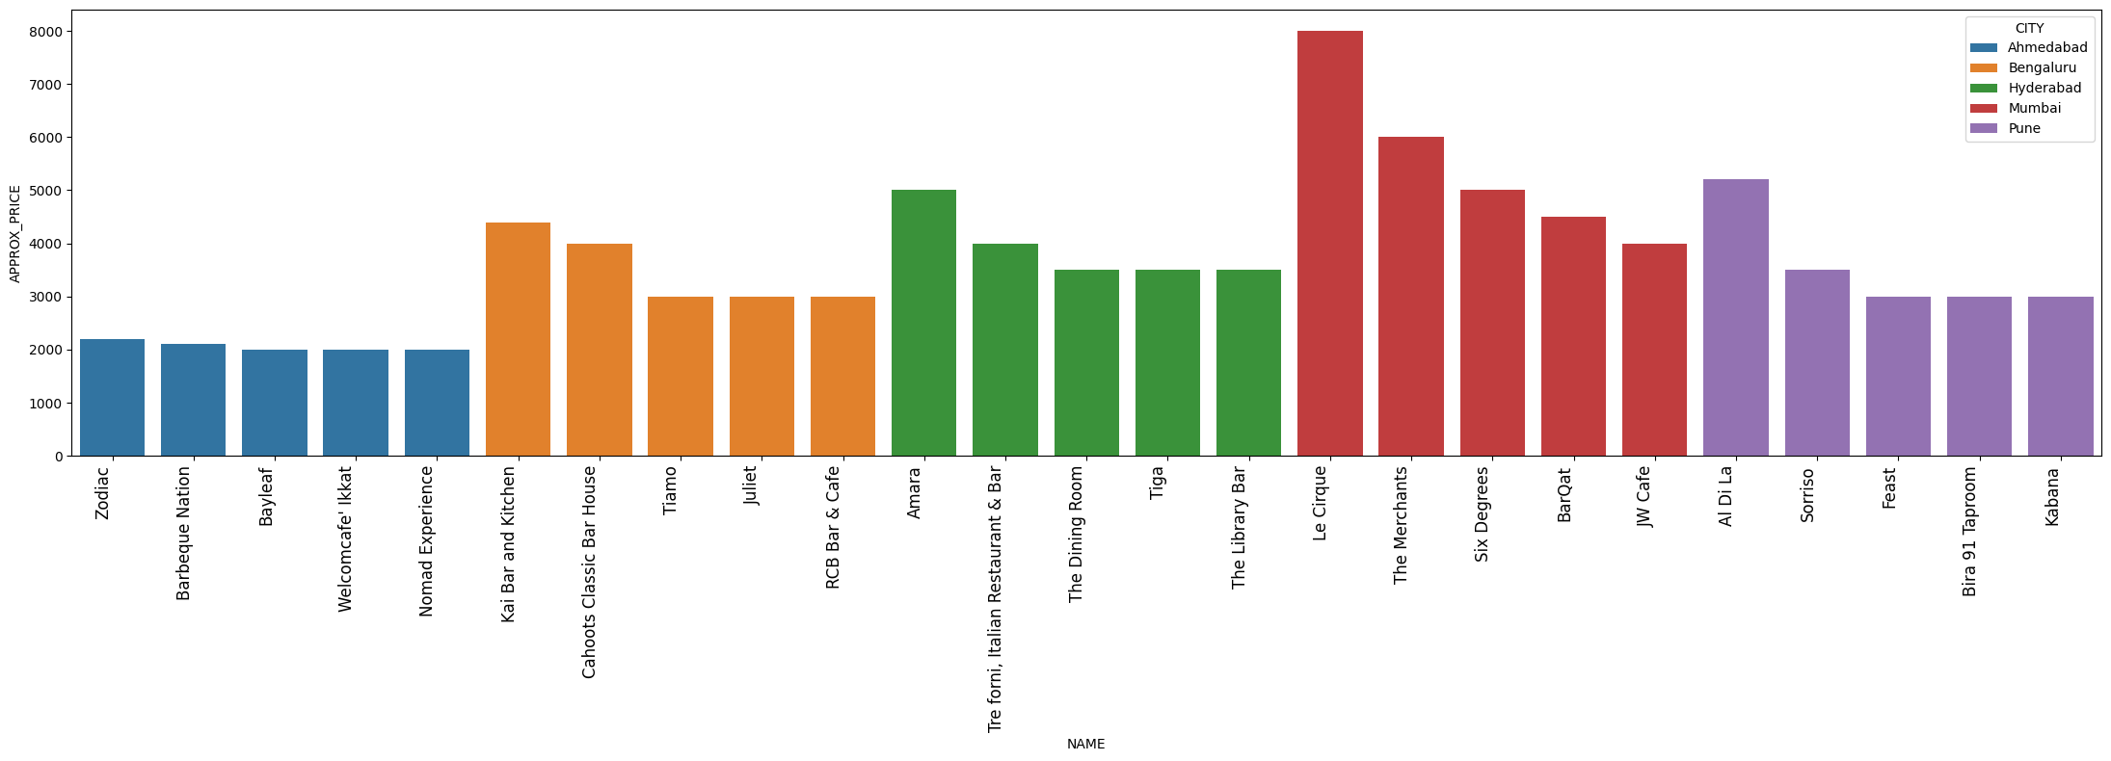
TOP 5 MOST EXPENSIVE RESTAURANTS IN EACH CITY

Slide 17


